Slide 1
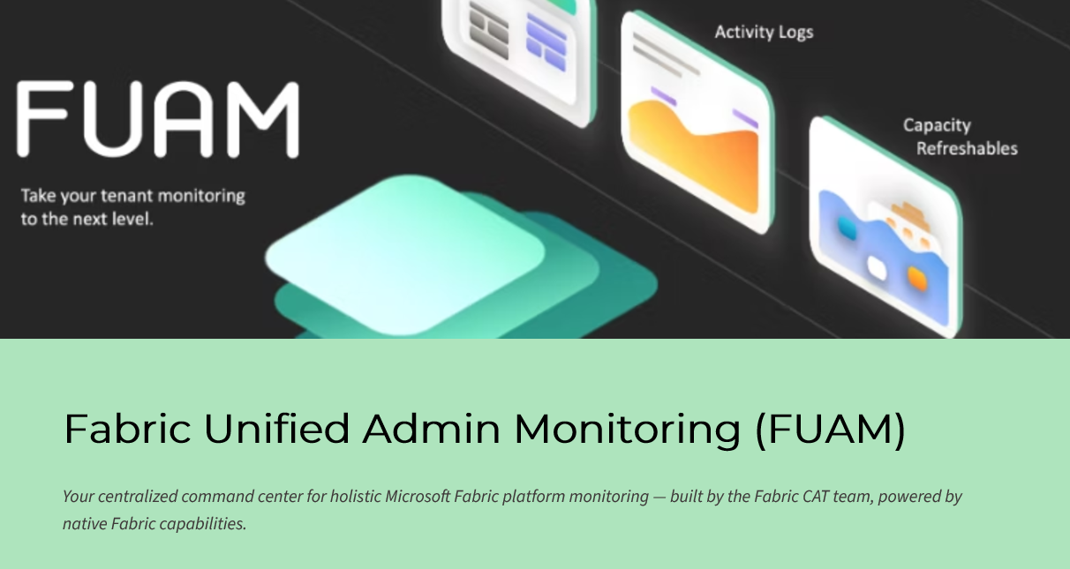

Slide 2
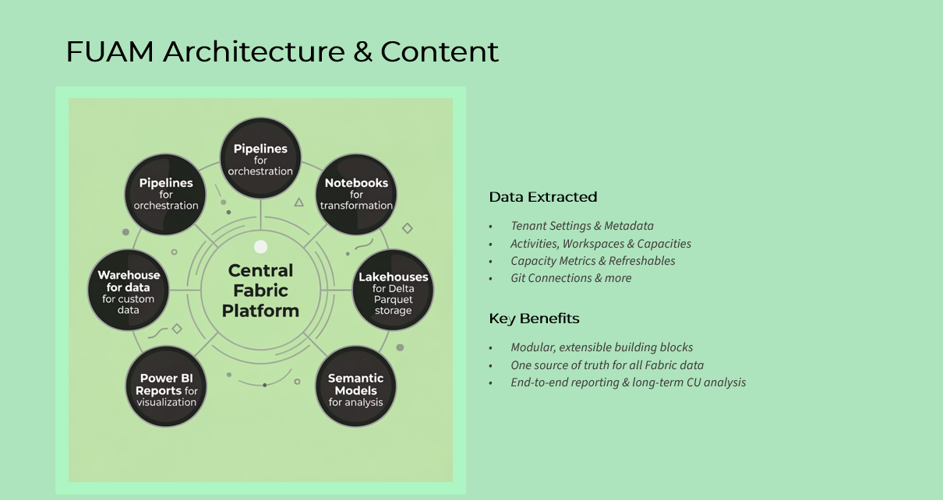

Slide 3
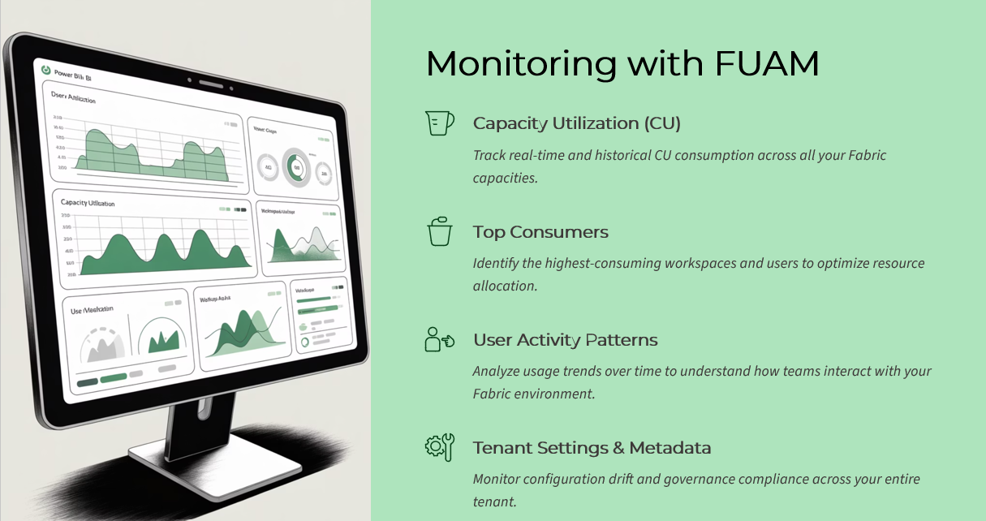

Slide 4
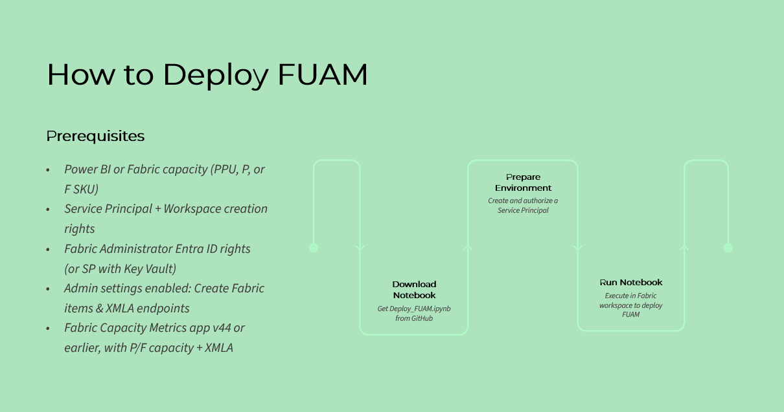

Slide 5
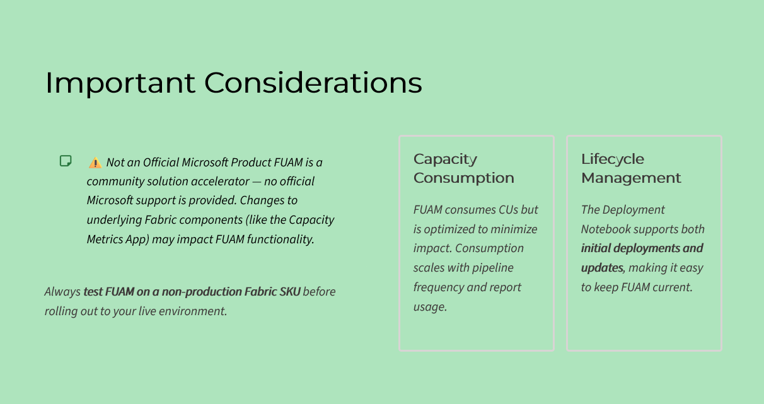

Slide 6
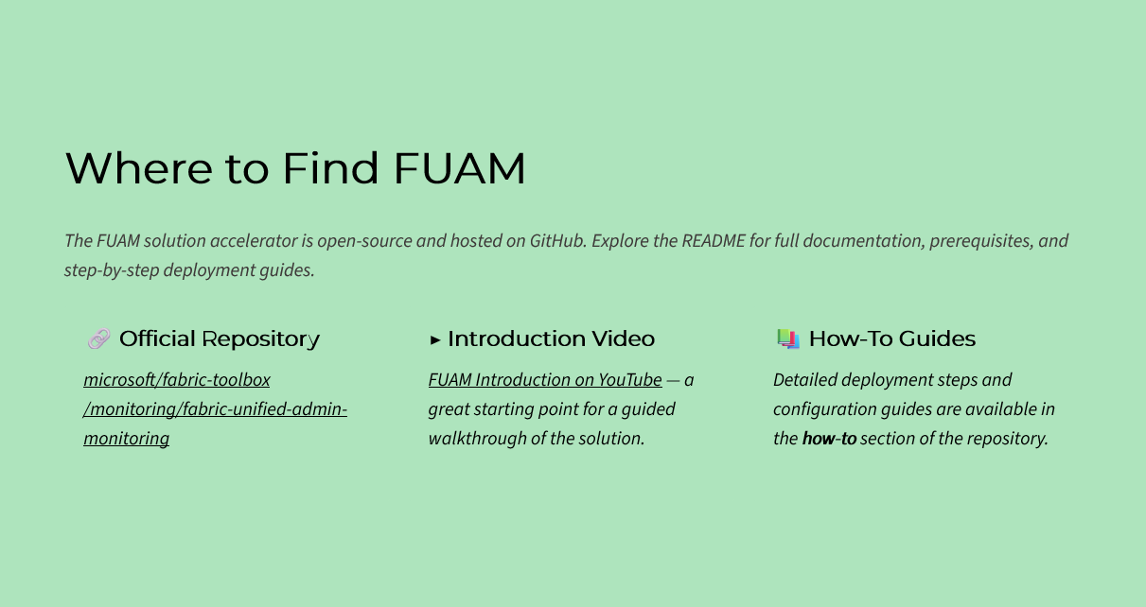
https://github.com/microsoft/fabric-toolbox/tree/main/monitoring/fabric-unified-admin-monitoring
https://youtu.be/CmHMOsQcMGI

